Slide 1
Study of Emotions using CWB Hair Scan Technology
with Dr. Otilia Tiutin PhD, DNM
www.otiliatiutin.com
Case Studies – Themes Related to Emotions
Gene Mutations and Effects on Emotions
The Role of Energy Body and Practical Applications
1

Slide 2
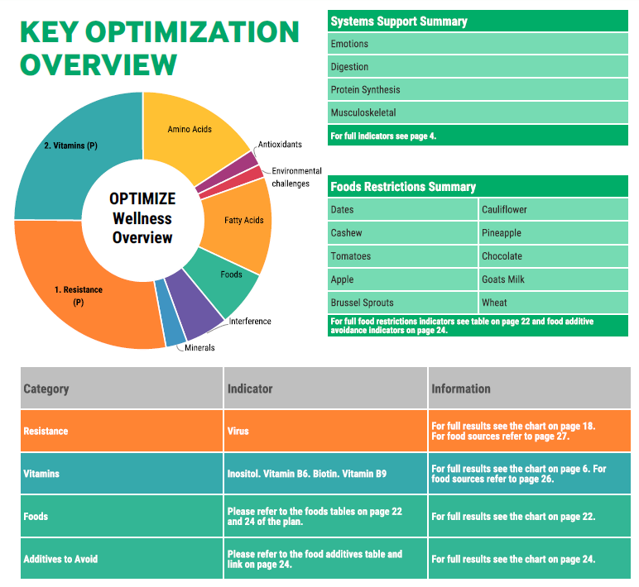
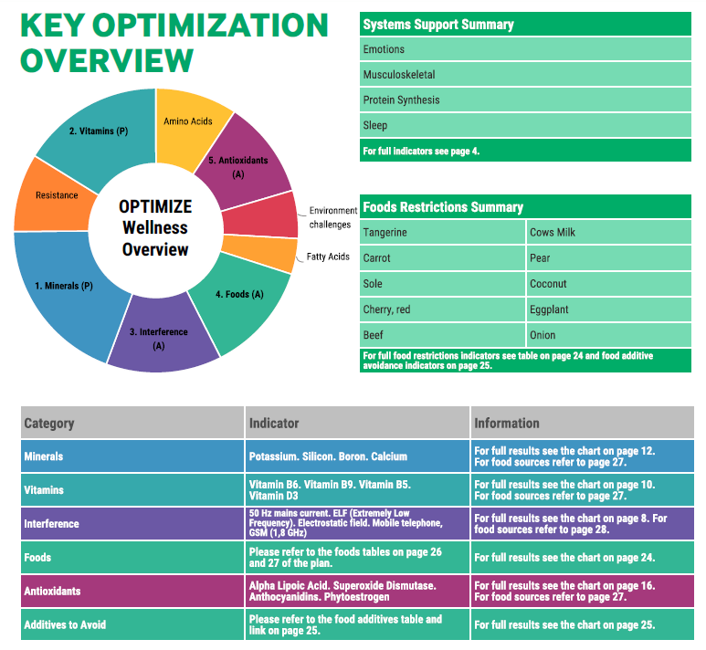
1. Six Clients: 3 Females, 3 Males presenting with Emotions Highlighted under System Support Summary
#2
#1

Slide 3
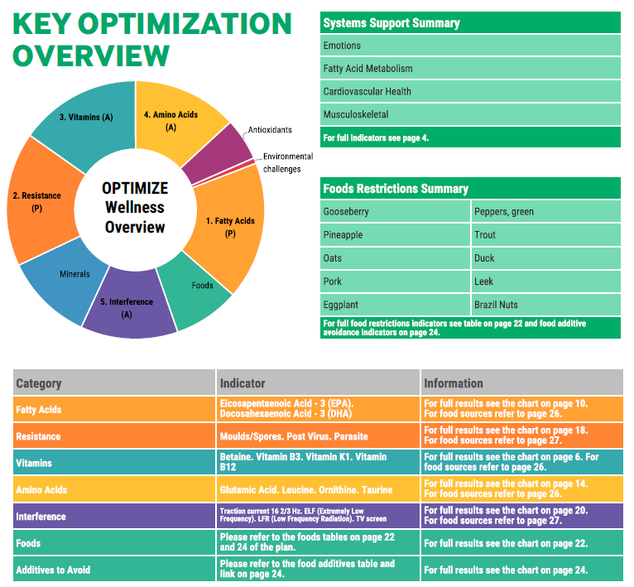
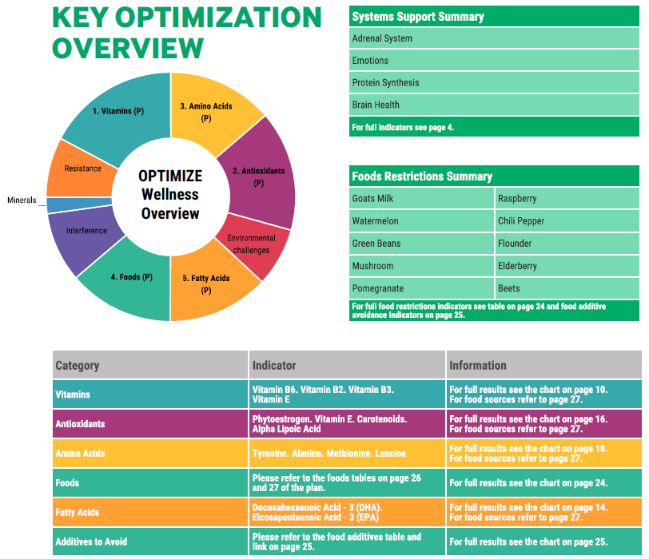
1. Case Studies - Themes Related to Emotions
#3
#4

Slide 4
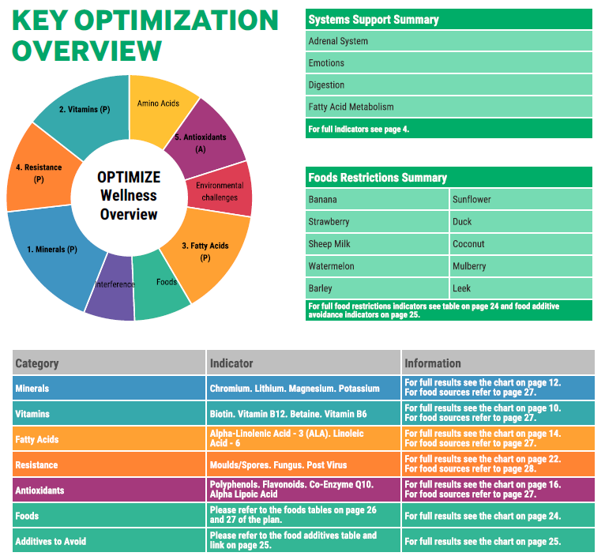
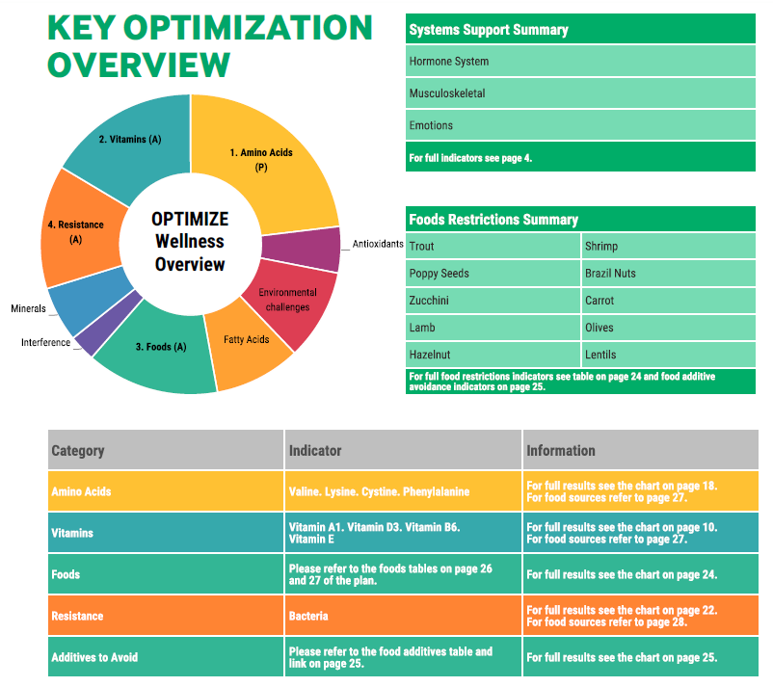
1. Case Studies - Themes Related to Emotions
#5
#6

Slide 5
1. Themes Related to Emotions & Practical Solutions
Protein Synthesis, Digestion, Musculoskeletal
Gut – Virus, Bacteria, Fungus, Parasites
Circulatory Support - High or Medium
Amino Acids
B Vitamins – B6, B9, B12,
EMF’s
Antioxidants
Minerals
Fatty Acids, Omega 3
Nutritional Solutions
Digestive Enzymes
Probiotics, Fermented Foods, Bone broth, Cleansing
Hemp Seeds (have the 8 Essential Amino Acids)
Use Methylated B’s, Antioxidants
Supplement with Trace Minerals and Magnesium
  Magnesium has 300 + functions in the body, precursor to serotonin which supports emotional well-being
Too much Omega 6 and 9 creates imbalance in Omega 3
EMF Solutions – Next Page
“Symbiotic bacteria turn into aggressive pathogens when exposed to EMF’s”
Dr. Dietrich Klinghardt M.D.
Expert in chronic disease and EMF Solutions

Slide 6
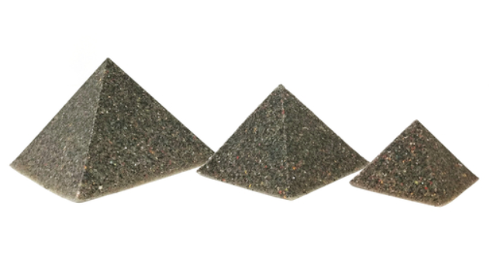

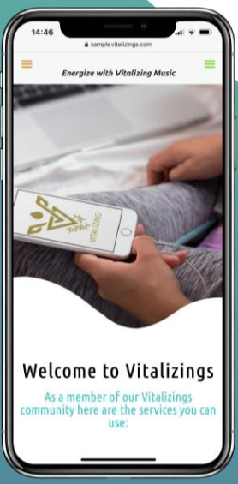



EMF SOLUTIONS
Earthing.com
https://shop.vibesup.com/#OtiliaT
Smartmeterguard.com

Slide 7
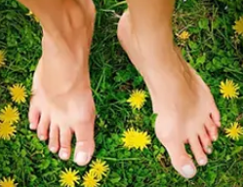
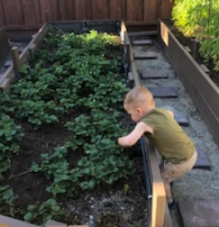


What do Plants Need to Grow and Thrive?
Earth
  Walk Barefoot
Sun
  Walk early morning
Water
  Drink spring/structured water
Maybe we need the same…

Slide 8
2. GENE MUTATIONS & EFFECTS ON EMOTIONS
MTHFR – Mutation
Methylenetetrahydrofolate Reductase – important enzyme in methylation function. Body can not detox properly if MTHFR gene is dirty. Lifestyle and habits can determine if genes act dirty or clean.
Solutions
To clean MTHFR Gene & reduce symptoms
Consume natural folate from food or supplement with L-methylfolate
Methylated B’s is a must
HomocysteX Plus if Homocysteine level is high
Avoid any processed food or supplements with with folic acid
Eat leafy greens, lentils, vegetables, eat organic whole foods
Focus on digestion, digestive enzymes, probiotics
Spend time in nature – moderate exercise only
Limit exposure to chemicals
Practice yoga and deep breathing exercises
Implications can be:
Anxiety, brain fog, depression, chemical sensitivity,
Irritability, inflammation, autoimmune, hormonal issues, miscarriages, autism, bipolar, breast cancer, fibromyalgia, high PB, Leukemia, MS, Migraines, Parkinson's, spinal bifida, tong tie, etc.
High homocysteine level – excessive blood clotting
Higher risk of heavy metal toxicity
Poor absorption of folic acid

Slide 9
2. Gene Mutations & Effects on Emotions ( Cont.)
MAOA - Mutation causes Monamine Oxidase A, enzyme deficiency
Produces enzymes that process dopamine and norepine-
phrine which help you deal with stress response, process serotonin which helps us feel calm and optimistic.
Solutions:
Key habits for healthy MAOA
Implications of a dirty MAOA can be:
Mood swings, difficulty falling asleep, prolonged anxiety,
Startle reflex, headaches, irritability, anxiety
Rage/aggressive behavior, difficulty relaxing,
Alcoholism and other addictions, ADHD,
Carb/sugar cravings, depression, sleep issues
Fatigue, flat affect, Alzheimer's
Bipolar disorders, panic disorders, Schizophrenia
Seasonal affective disorder, antisocial
Obsessive compulsive disorder
Consume Food sources of:
Riboflavin/B2 - liver, lamb, mushrooms, spinach, almonds, wild salmon, eggs
Tryptophan – seaweed, pumpkin seeds, turnip greens, red lettuce, asparagus
Clean diet, eliminate chemicals,
Manage stress – spend time in nature,
4-7-8 breathing method
Sleep well
Source: Book, Dirty Genes, by Dr. Ben Lynch N.D.

Slide 10
3. The Role of Energy Body and Emotions
Practical Applications
Source: Quantum University of Integrative Medicine

Slide 11

3. Energy Centers, Organs & Feelings
Source: Quantum University of Integrative Medicine
Ways to balance energy centers: Yoga, Cryxon Light Therapy, Hands on balancing by practitioner or using Essential Oils. Essential oils: frankincense, clary sage, lemon, peppermint, lime, lavender, rosemary, (in spray bottle with distilled water add 7 drops of each oil)

Slide 12
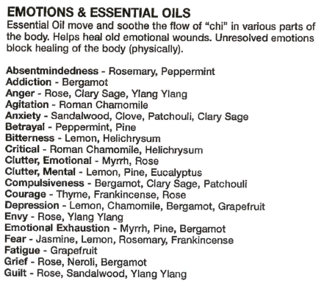
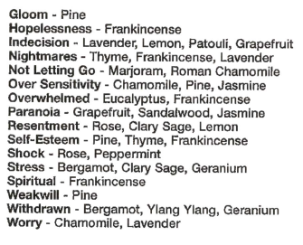
Source: Natures Treasure Chest, by Dr. Joan Vandergriff N.D.
3. How Can We Balance Emotions

Slide 13
3. How Can We Balance Emotions (Cont.)
Emotions contribute to significant changes in body functions
Negative Emotions: Put the body into Fight or Flight, increases inflammation, suppresses digestion, weakens immune system, increases cortisol/stress hormone, pH Level becomes acidic, constricts blood flow to vital organs, etc.
Positive Emotions: Body releases oxytocin, serotonin and dopamine, feeling happy, relaxed, increase in white blood cell count, lengthen telomeres, lowers cortisol, lowers BP, strengthen immune system, more focused and creative.
Emotions have two separate components: a perception of feeling and the response. The brain monitors feeling and then responds with physiological and behavioral action. The brain can be taught to develop the ability to elicit emotional response to the feeling that is the most desired. This ability is called emotional intelligence (Blackett, 2014).
2020 Research Study by Dr. Borowski M.D. PhD, The Affects of Positive Emotions on Oxidative Stress
Method: Heart Centered Breathing 10 min – 2 times a week for 6 weeks
Focused on Love, Gratitude and Appreciation
Results: 71% of participants had statistically significant improvement in Oxidative Stress measured by ESR – Erythrocyte Sedimentation Rate a blood test measuring Oxidative Stress/Inflammation
Take way: Simple breathing exercises and positive thoughts can go a long way to improving health.

Slide 14
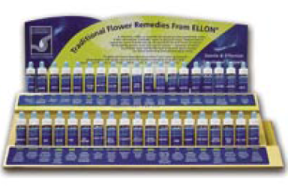
3. How Can We Balance Emotions (Cont.)
Bach Flower Remedies – 38 Flower Essences developed by Dr. Bach MD, in 1930’s in England.
Dr. Edward Bach, a physician and homeopath discovered that stress, if left unresolved leads to physical illness. Dr. Bach spent his life exploring the use of flowers and plants to bring a simple, natural and gentler approach to emotional balance.
Flower essences are grouped by categories:
Fear, Loneliness, Oversensitivity, Uncertainty Lack of interest in the present, Over concerned for others, Despair.
A questionnaire is used to determine symptoms & priority
Up to 7 flowers can be used in one custom blend
After use, client may feel the need to talk about past events
Journaling is helpful, stuck emotions & trauma are released in layers, only so much can be processed at one time.
After 60 days, new questionnaire, new flower drops
www.bachremedies.com

Slide 15
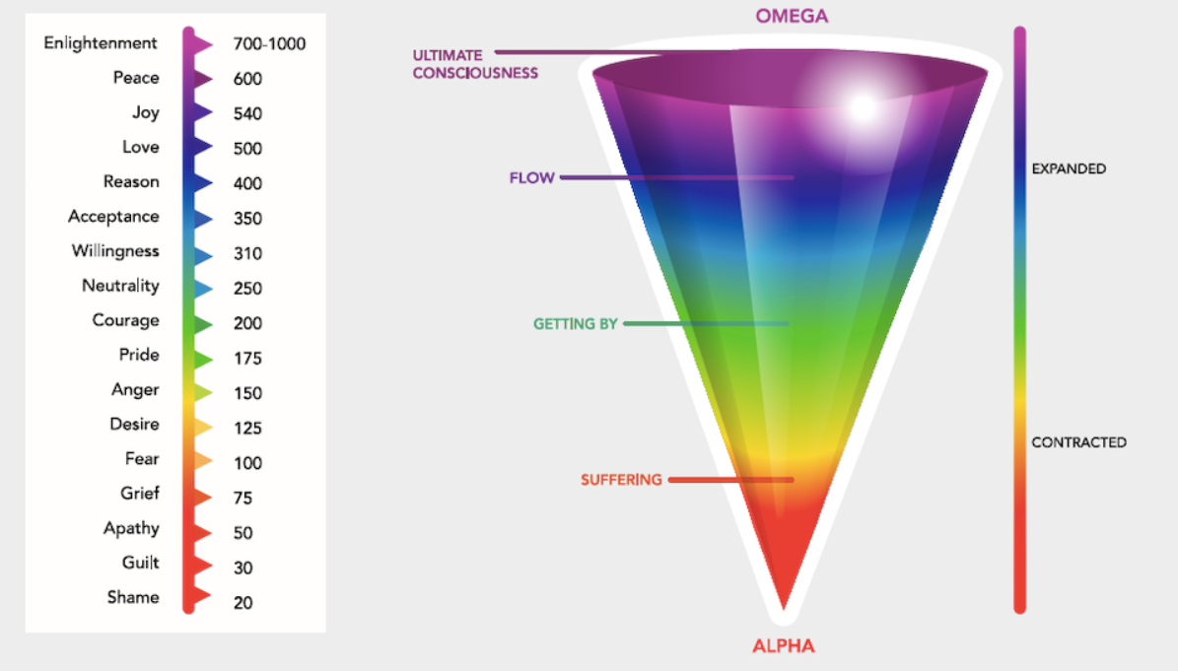
3. The Power of Emotions
Dr. David Hawkins calibrated the level of emotions on a scale of 1-1000
Book: Power vs. Force by Dr. David Hawkins MD, PhD

Slide 16
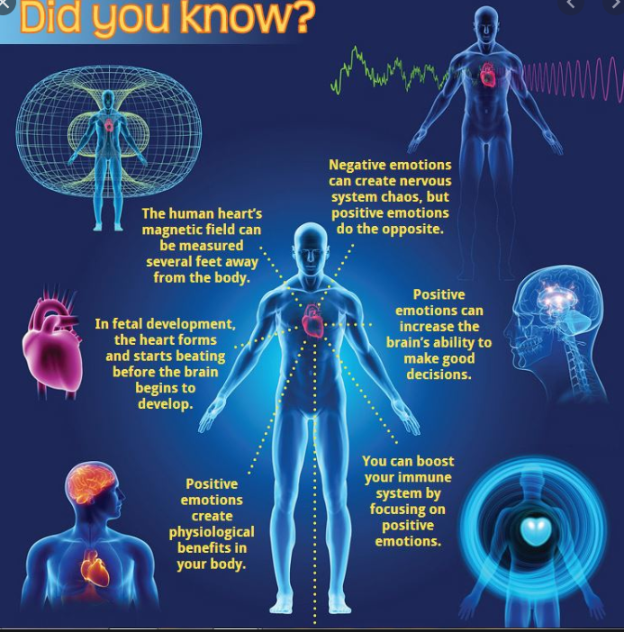
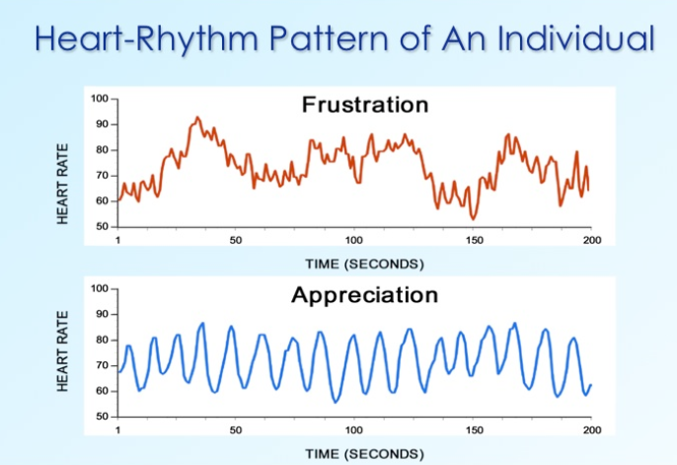
3. The Power of the Human Heart
HeartMath Institute - www.heartmath.org

Slide 17
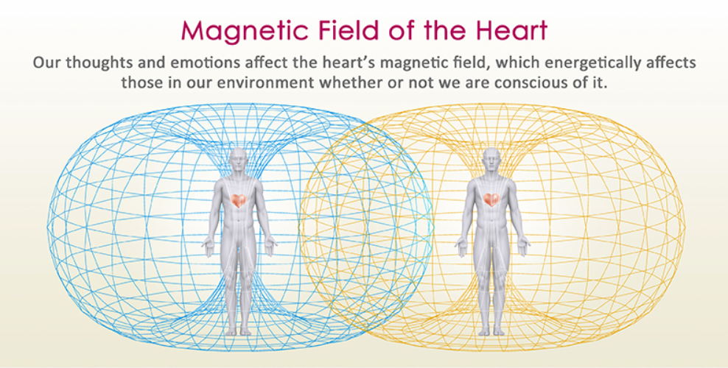
3. Who Do We Share Energy With
HeartMath Institute - www.heartmath.org

Slide 18

T
Thank you for you time
Dr. Otilia Tiutin PhD, DNM
www.otiliatiutin.com
otiutin@yahoo.com
925-207-0966

